Slide 1
2-adic numbers and quadratic equations
By Will Boultinghouse and co-author Dr. Justin Trulen

Slide 2
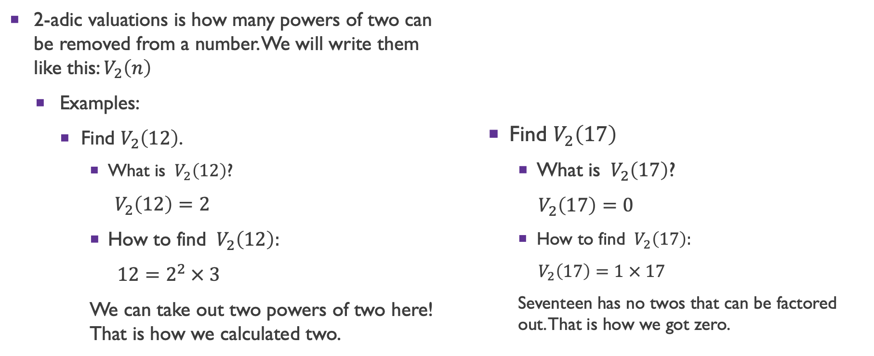
2-adic Valuations
2-adic valuations is how many powers of two can be removed from a number. We will write them like this: $V_{2}\left(n\right)$
  Examples:
    Find $V_{2}\left(12\right)$.
      What is $V_{2}\left(12\right)$?
      $V_{2}\left(12\right)=2$
      How to find $V_{2}\left(12\right):$
      $12=2^{2} × 3$
      We can take out two powers of two here! That is how we calculated two.
    Find $V_{2}\left(17\right)$
      What is $V_{2}\left(17\right)$?
    $V_{2}\left(17\right)=0$
      How to find $V_{2}\left(17\right):$
      $V_{2}\left(17\right)=1 × 17$
      Seventeen has no twos that can be factored out. That is how we got zero.

Slide 3
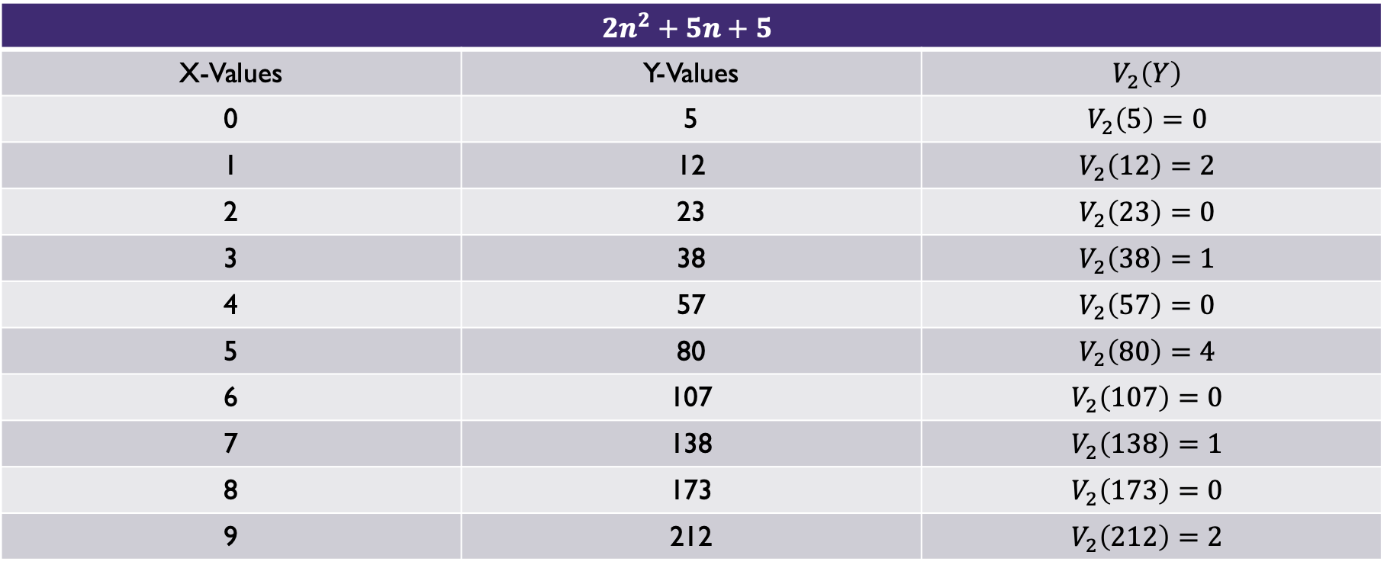
2-adic Valuations of Quadratic Equations
$$2n^{2}+5n+5$$
X-Values | Y-Values | $$V_{2}\left(Y\right)$$
0 | 5 | $$V_{2}\left(5\right)=0$$
1 | 12 | $$V_{2}\left(12\right)=2$$
2 | 23 | $$V_{2}\left(23\right)=0$$
3 | 38 | $$V_{2}\left(38\right)=1$$
4 | 57 | $$V_{2}\left(57\right)=0$$
5 | 80 | $$V_{2}\left(80\right)=4$$
6 | 107 | $$V_{2}\left(107\right)=0$$
7 | 138 | $$V_{2}\left(138\right)=1$$
8 | 173 | $$V_{2}\left(173\right)=0$$
9 | 212 | $$V_{2}\left(212\right)=2$$

Slide 4
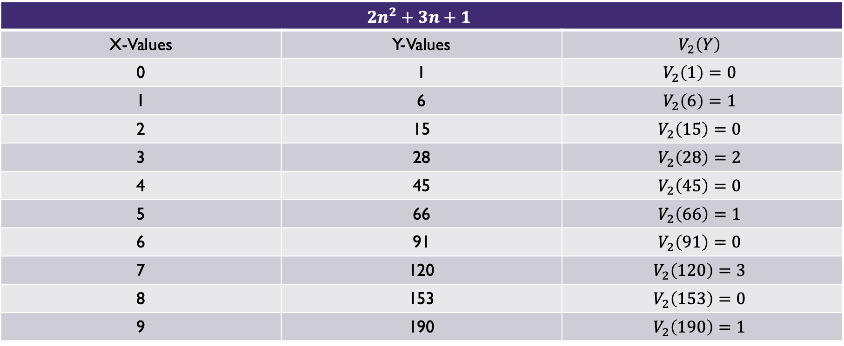
2-adic Valuations of Quadratic Equations
$$2n^{2}+3n+1$$
X-Values | Y-Values | $$V_{2}\left(Y\right)$$
0 | 1 | $$V_{2}\left(1\right)=0$$
1 | 6 | $$V_{2}\left(6\right)=1$$
2 | 15 | $$V_{2}\left(15\right)=0$$
3 | 28 | $$V_{2}\left(28\right)=2$$
4 | 45 | $$V_{2}\left(45\right)=0$$
5 | 66 | $$V_{2}\left(66\right)=1$$
6 | 91 | $$V_{2}\left(91\right)=0$$
7 | 120 | $$V_{2}\left(120\right)=3$$
8 | 153 | $$V_{2}\left(153\right)=0$$
9 | 190 | $$V_{2}\left(190\right)=1$$

Slide 5
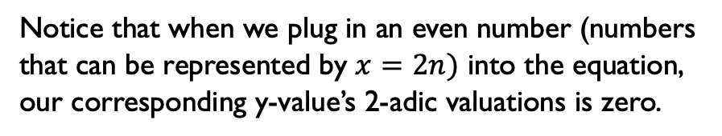
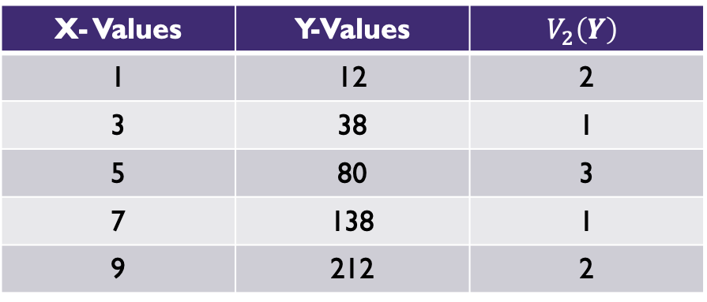
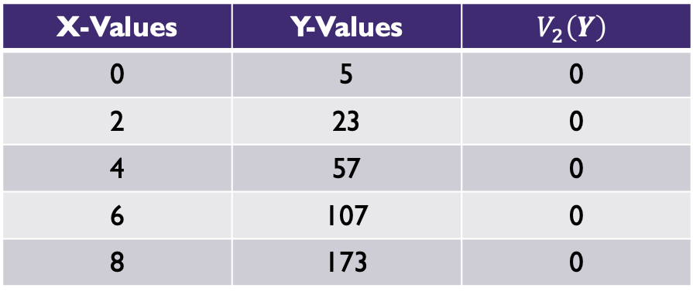

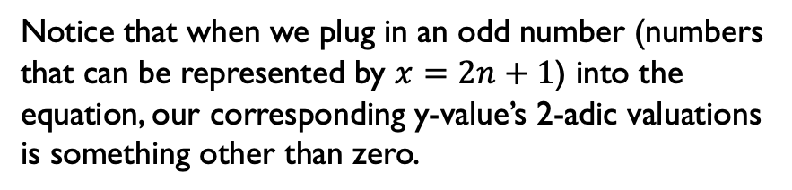
2-adic Valuations of the Equation $2n^{2}+5n+5$
Let’s look at our first equation of $2n^{2}+5n+5:$
X- Values | Y-Values | $$V_{2}\left(Y\right)$$
1 | 12 | 2
3 | 38 | 1
5 | 80 | 3
7 | 138 | 1
9 | 212 | 2
X-Values | Y-Values | $$V_{2}\left(Y\right)$$
0 | 5 | 0
2 | 23 | 0
4 | 57 | 0
6 | 107 | 0
8 | 173 | 0
Notice that when we plug in an odd number (numbers that can be represented by $x=2n+1$) into the equation, our corresponding y-value’s 2-adic valuations is something other than zero.
Notice that when we plug in an even number (numbers that can be represented by $x=2n)$ into the equation, our corresponding y-value’s 2-adic valuations is zero.

Slide 6

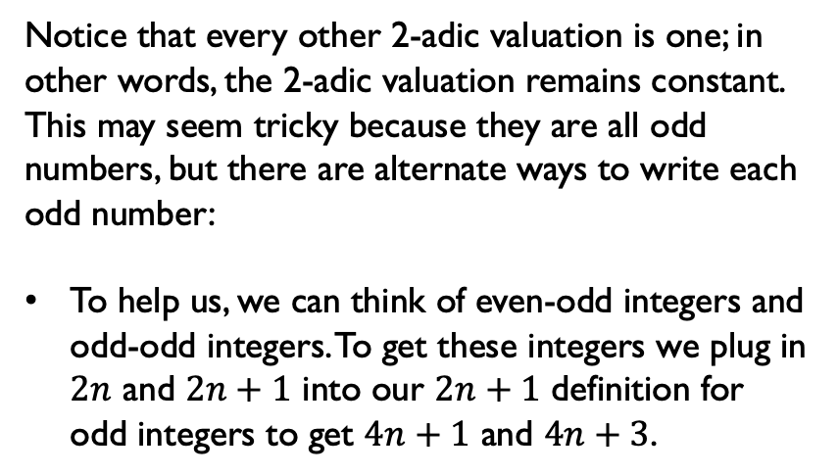
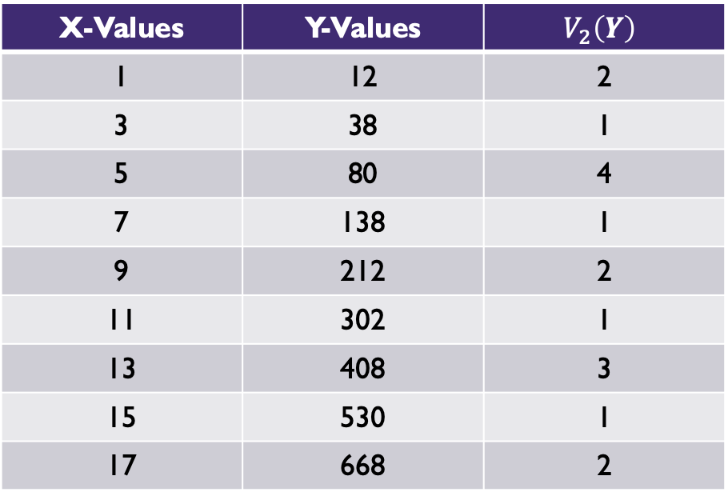
2-adic Valuations of the Equation $2n^{2}+5n+5$
Now let’s look at only the odd inputs for $2n^{2}+5n+5$ since these integers are the ones that give a nonzero 2-adic valuation:
X-Values | Y-Values | $$V_{2}\left(Y\right)$$
1 | 12 | 2
3 | 38 | 1
5 | 80 | 4
7 | 138 | 1
9 | 212 | 2
11 | 302 | 1
13 | 408 | 3
15 | 530 | 1
17 | 668 | 2
Notice that every other 2-adic valuation is one; in other words, the 2-adic valuation remains constant. This may seem tricky because they are all odd numbers, but there are alternate ways to write each odd number:
To help us, we can think of even-odd integers and odd-odd integers. To get these integers we plug in $2n$ and $2n+1$ into our $2n+1$ definition for odd integers to get $4n+1$ and $4n+3$.

Slide 7
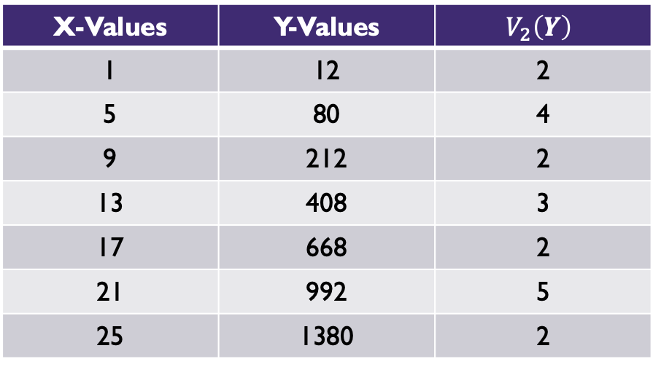
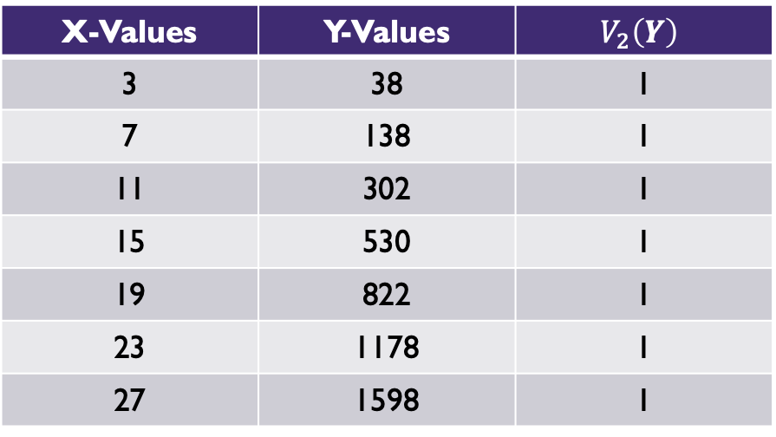
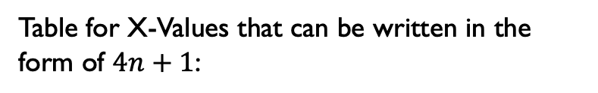
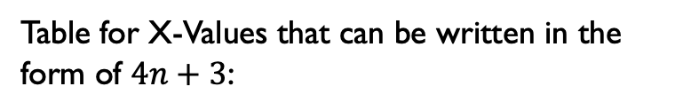
2-adic Valuations of the Equation $2n^{2}+5n+5$
Table for X-Values that can be written in the form of $4n+3$:
Table for X-Values that can be written in the form of $4n+1$:
X-Values | Y-Values | $$V_{2}\left(Y\right)$$
3 | 38 | 1
7 | 138 | 1
11 | 302 | 1
15 | 530 | 1
19 | 822 | 1
23 | 1178 | 1
27 | 1598 | 1
X-Values | Y-Values | $$V_{2}\left(Y\right)$$
1 | 12 | 2
5 | 80 | 4
9 | 212 | 2
13 | 408 | 3
17 | 668 | 2
21 | 992 | 5
25 | 1380 | 2
The biggest takeaway from these two tables is the application from the previous slide: the integers that can be written as $4n+3$ have a constant unanimous 2-adic valuation of $1$ while integers that can be written in the form of $4n+1$ have varying 2-adic valuations.

Slide 8
2-adic Valuation Tree Model
Dr. Trulen along with some colleagues developed an Octave program to quickly depict what is going on. The program builds a model that we call “Trees.” These trees show us the same data as the charts discussed earlier but more concise.
This program only checks a finite number of terms before determining whether there is split or not, and the program can only do so much splitting before it stops. Although these are obvious limitations, we will explore the theory to overcome them.

Slide 9
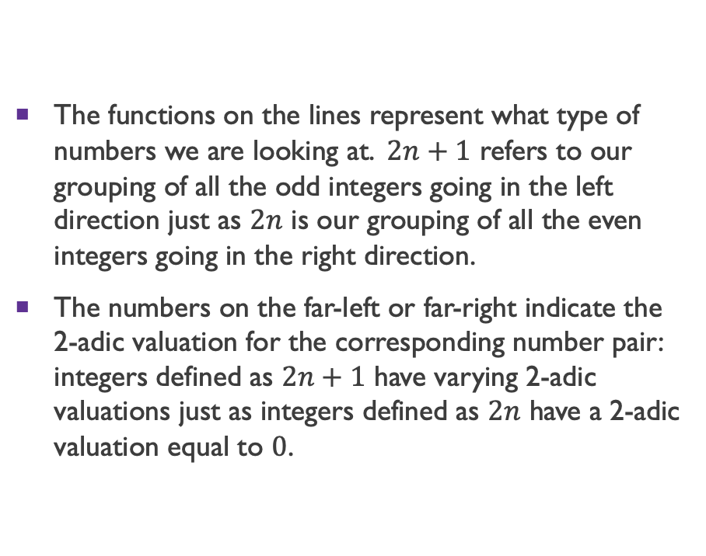
2-adic Valuation Tree Model
The functions on the lines represent what type of numbers we are looking at. $2n+1$ refers to our grouping of all the odd integers going in the left direction just as $2n$ is our grouping of all the even integers going in the right direction.
The numbers on the far-left or far-right indicate the 2-adic valuation for the corresponding number pair: integers defined as $2n+1$ have varying 2-adic valuations just as integers defined as $2n$ have a 2-adic valuation equal to $0$.

Slide 10
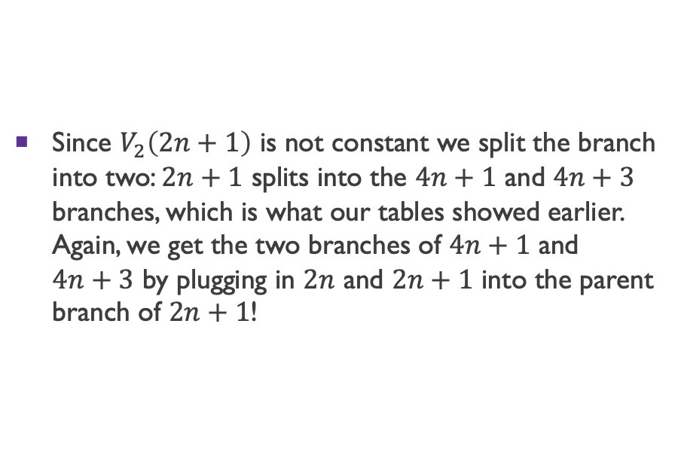
2-adic Valuation Tree Model
Since $V_{2}\left(2n+1\right)$ is not constant we split the branch into two: $2n+1$ splits into the $4n+1$ and $4n+3$ branches, which is what our tables showed earlier. Again, we get the two branches of $4n+1$ and $4n+3$ by plugging in $2n$ and $2n+1$ into the parent branch of $2n+1$!

Slide 11
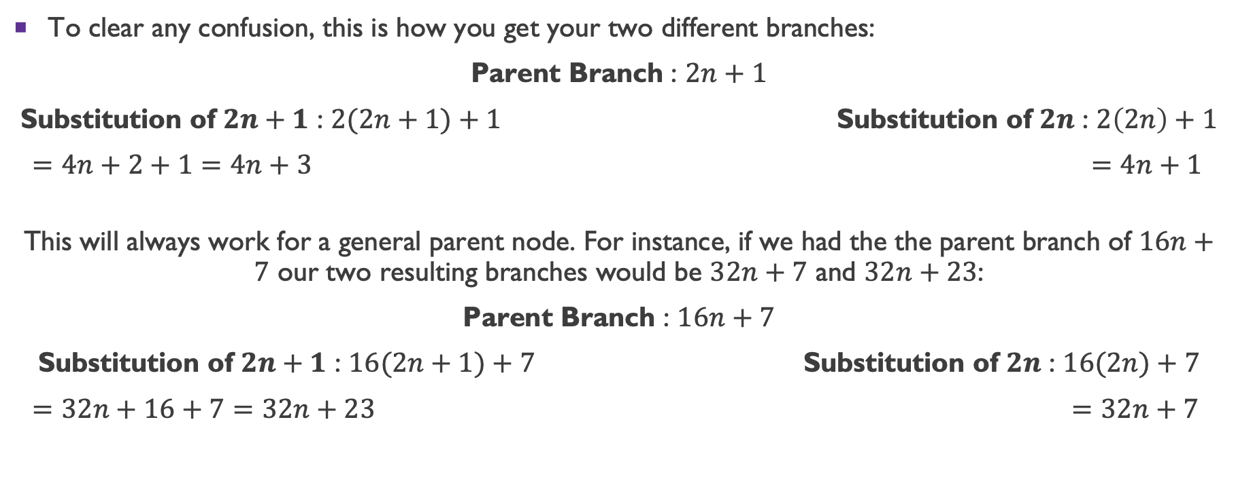
2-adic Valuation Tree Model
To clear any confusion, this is how you get your two different branches:
Parent Branch : $2n+1$
Substitution of $2n+1$ : $2(2n+1)+1$ Substitution of $2n$ : $2\left(2n\right)+1$
$=4n+2+1=4n+3$ $=4n+1$
This will always work for a general parent node. For instance, if we had the the parent branch of $16n+7$ our two resulting branches would be $32n+7$ and $32n+23$:
Parent Branch : $16n+7$
Substitution of $2n+1$ : $16(2n+1)+7$ Substitution of $2n$ : $16(2n)+7$
$=32n+16+7=32n+23$ $=32n+7$

Slide 12
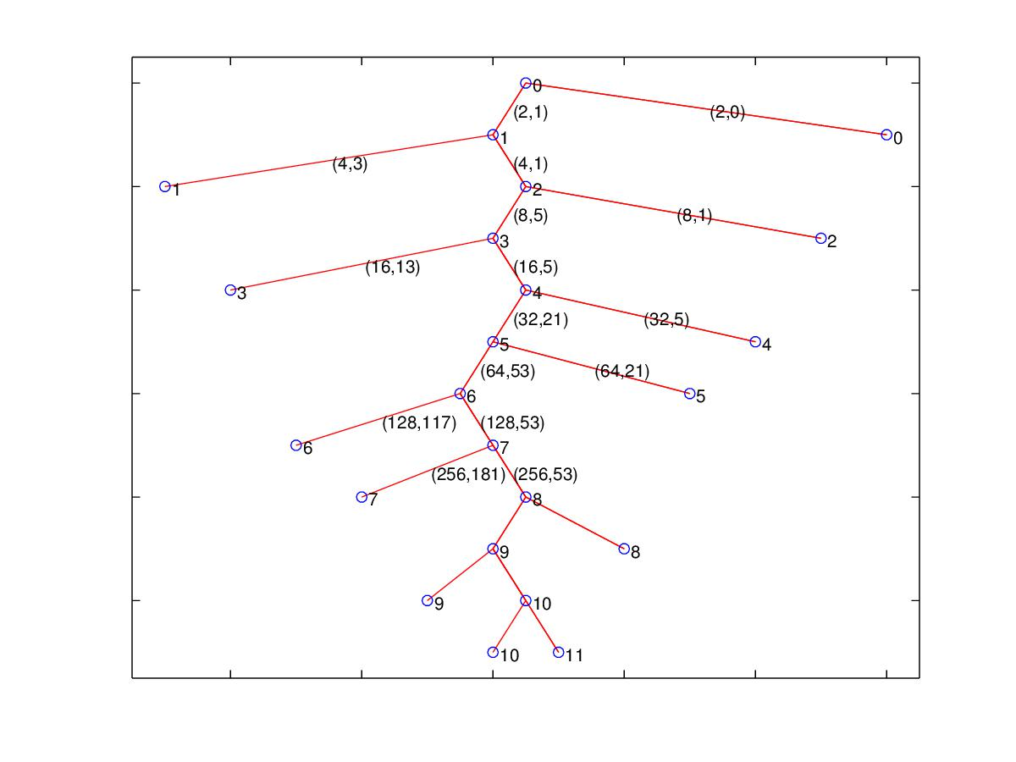

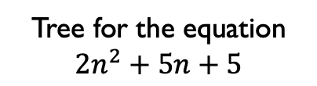
Tree Model for $2n^{2}+5n+5$
Tree for the equation
$$2n^{2}+5n+5$$

Slide 13
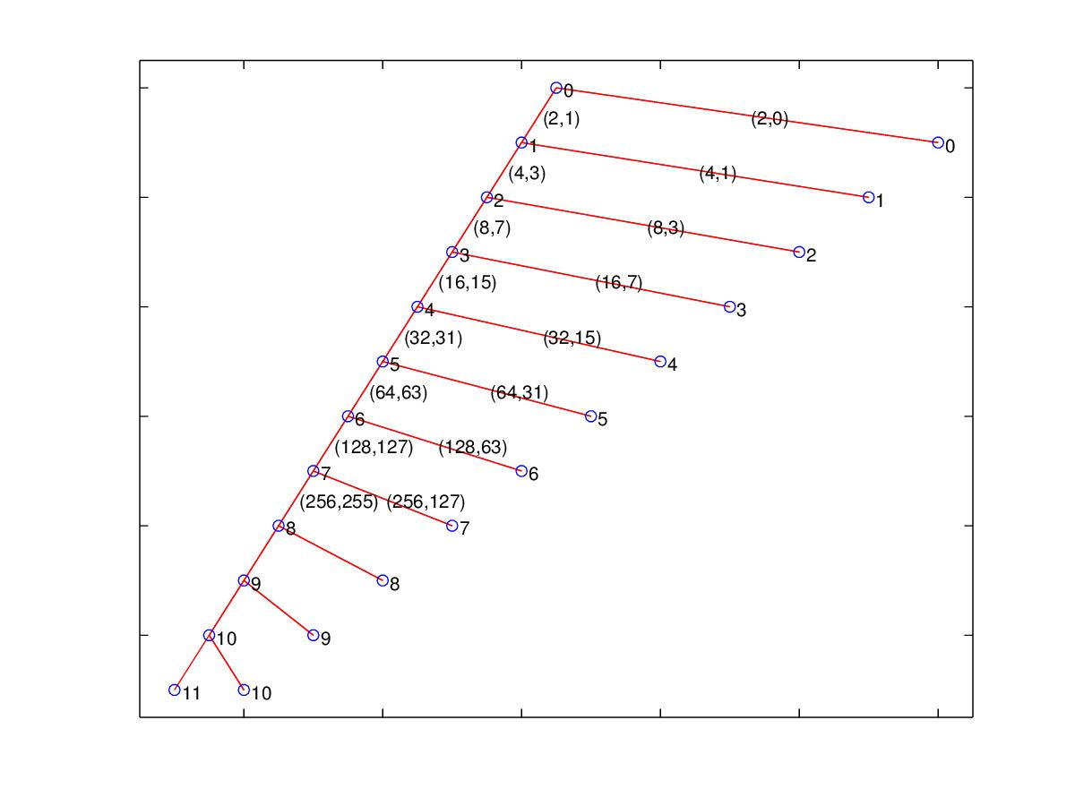

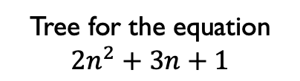
Tree Model for $2n^{2}+3n+1$
Tree for the equation
$$2n^{2}+3n+1$$

Slide 14
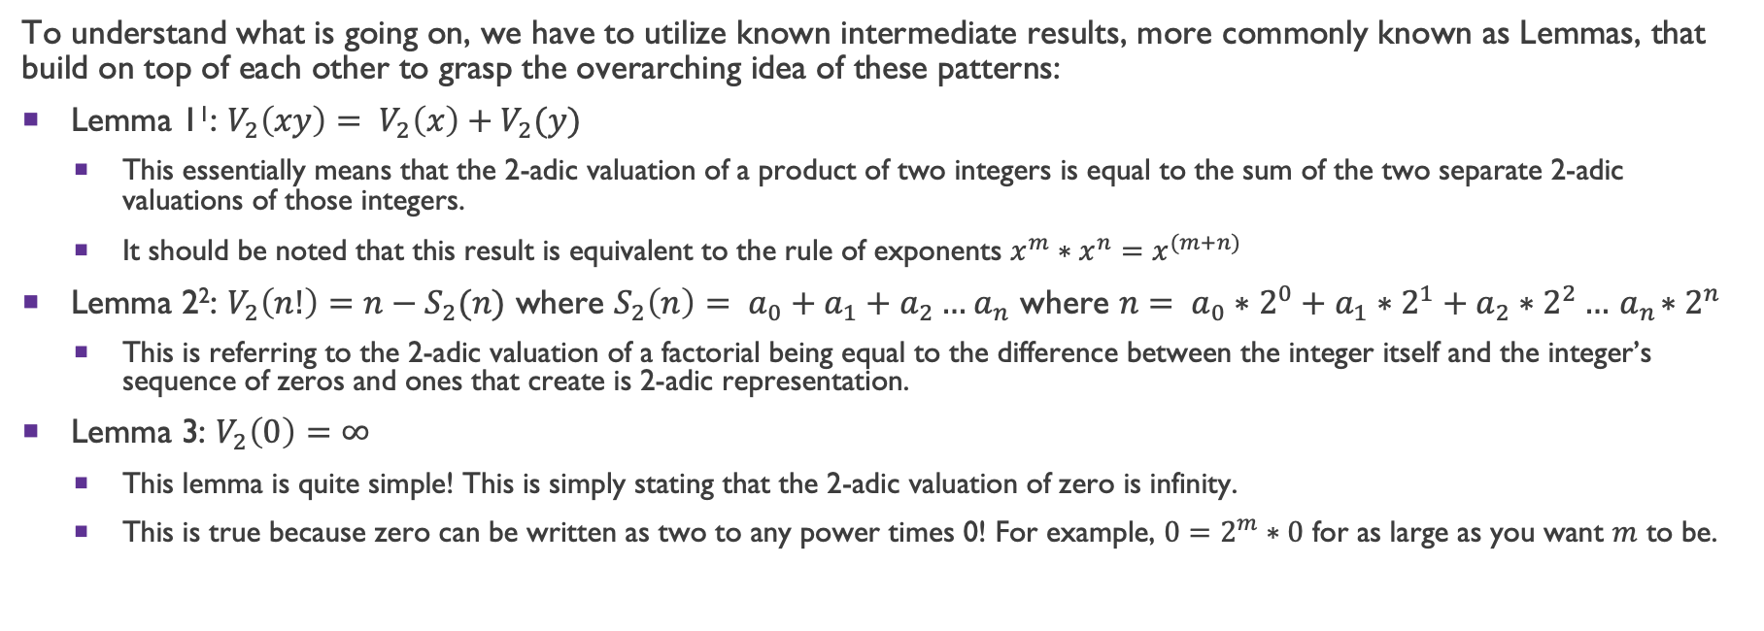
Theory
To understand what is going on, we have to utilize known intermediate results, more commonly known as Lemmas, that build on top of each other to grasp the overarching idea of these patterns:
Lemma 1¹: $V_{2}\left(xy\right)= V_{2}\left(x\right)+V_{2}(y)$
  This essentially means that the 2-adic valuation of a product of two integers is equal to the sum of the two separate 2-adic valuations of those integers.
  It should be noted that this result is equivalent to the rule of exponents $x^{m}∗x^{n}=x^{(m+n)}$
Lemma 2²: $V_{2}\left(n!\right)=n−S_{2}(n)$ where $S_{2}\left(n\right)= a_{0}+a_{1}+a_{2}…{ a}_{n}$ where $n= a_{0}∗2^{0}+a_{1}∗2^{1}+a_{2}∗2^{2}…{ a}_{n}∗2^{n}$
  This is referring to the 2-adic valuation of a factorial being equal to the difference between the integer itself and the integer’s sequence of zeros and ones that create is 2-adic representation.
Lemma 3: $V_{2}\left(0\right)=∞$
  This lemma is quite simple! This is simply stating that the 2-adic valuation of zero is infinity.
  This is true because zero can be written as two to any power times 0! For example, $0=2^{m}∗0$ for as large as you want $m$ to be.

Slide 15
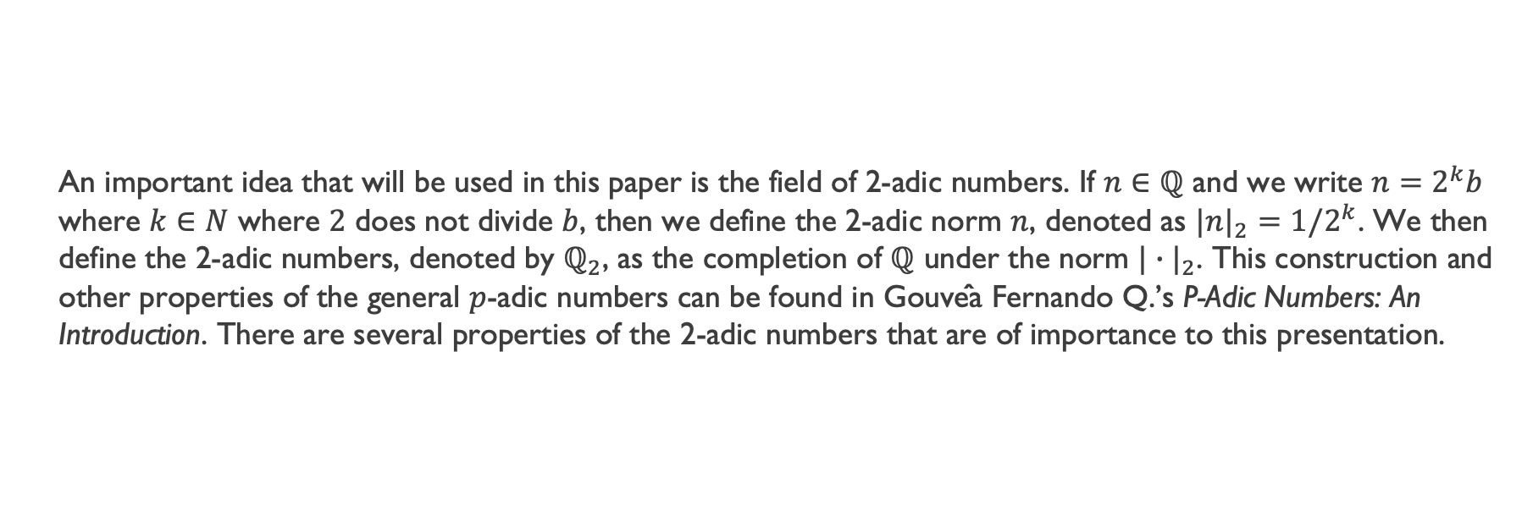
Theory
  An important idea that will be used in this paper is the field of 2-adic numbers. If $n∈ℚ$ and we write $n=2^{k}b$ where $k∈N$ where $2$ does not divide $b$, then we define the 2-adic norm $n$, denoted as $|n|_{2}=1/2^{k}$. We then define the 2-adic numbers, denoted by $ℚ_{2}$, as the completion of $ℚ$ under the norm ${|∙|}_{2}$. This construction and other properties of the general $p$-adic numbers can be found in Gouvêa Fernando Q.’s P-Adic Numbers: An Introduction. There are several properties of the 2-adic numbers that are of importance to this presentation.

Slide 16
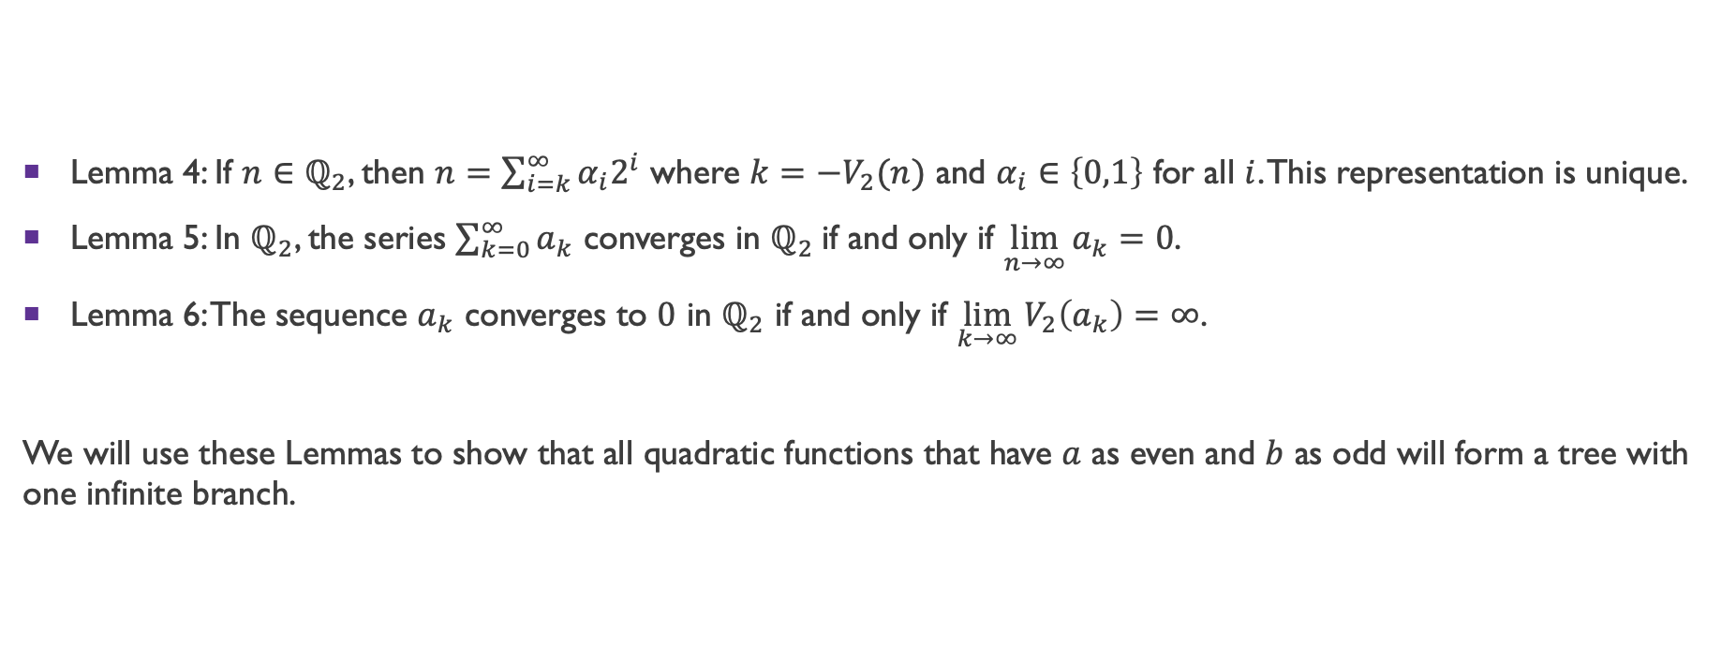
Theory
Lemma 4: If $n∈ℚ_{2}$, then $n=\sum_{i=k}^{∞}{α_{i}2^{i}}$ where $k={−V}_{2}(n)$ and $α_{i}∈\left\{0,1\right\}$ for all $i$. This representation is unique.
Lemma 5: In $ℚ_{2}$, the series $\sum_{k=0}^{∞}{a_{k}}$ converges in $ℚ_{2}$if and only if $\lim_{n→∞}{a_{k}=0}$.
Lemma 6: The sequence $a_{k}$ converges to $0$ in $ℚ_{2}$ if and only if $\lim_{k→∞}{V_{2}\left(a_{k}\right)=∞}$.
We will use these Lemmas to show that all quadratic functions that have $a$ as even and $b$ as odd will form a tree with one infinite branch.

Slide 17
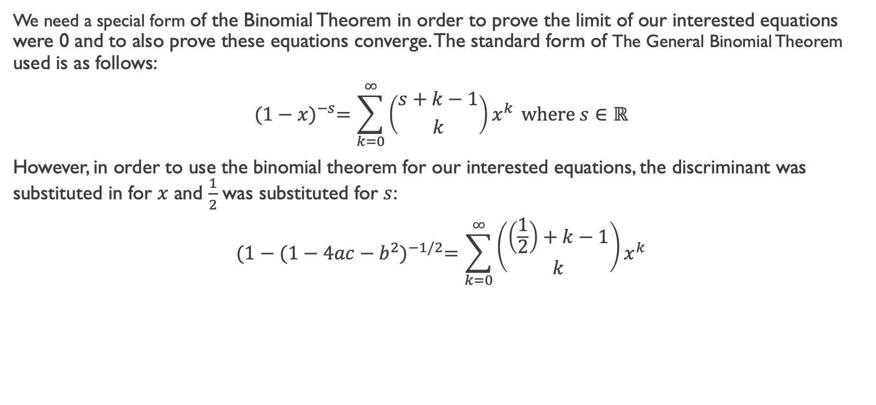
Theory
We need a special form of the Binomial Theorem in order to prove the limit of our interested equations were 0 and to also prove these equations converge. The standard form of The General Binomial Theorem used is as follows:
$${(1−x)}^{−s}=\sum_{k=0}^{∞}{\left({s+k−1 \atop k}\right)x^{k}} where s∈ℝ$$
However, in order to use the binomial theorem for our interested equations, the discriminant was substituted in for $x$ and $\frac{1}{2}$ was substituted for $s$:
$${(1−(1−4ac−b^{2})}^{−1/2}=\sum_{k=0}^{∞}{\left({\left(\frac{1}{2}\right)+k−1 \atop k}\right)x^{k}}$$

Slide 18
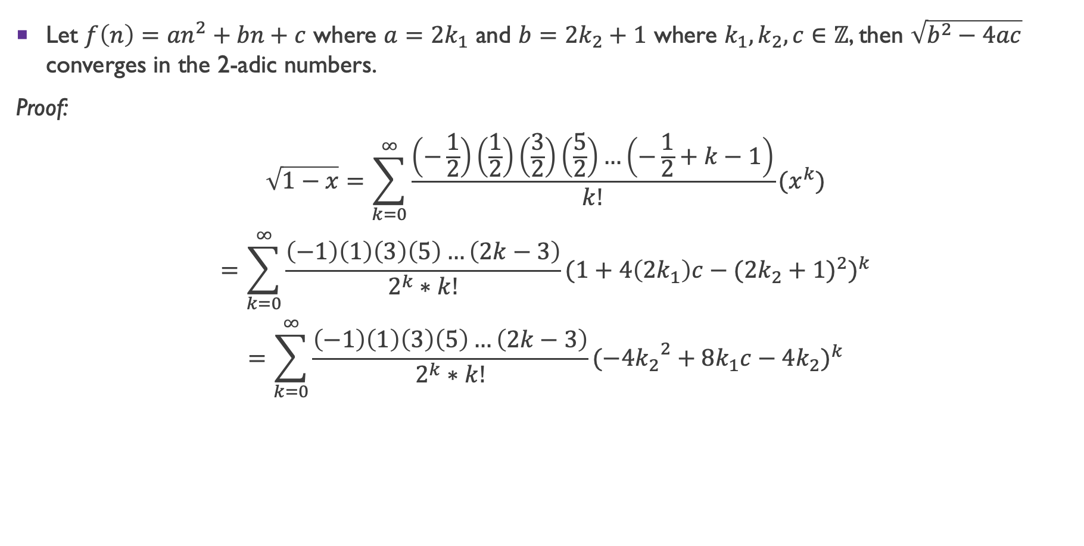
Theorem
Let $f\left(n\right)={an}^{2}+bn+c$ where $a={2k}_{1}$ and $b={2k}_{2}+1$ where $k_{1},k_{2},c∈ℤ$, then $\sqrt{b^{2}−4ac}$ converges in the 2-adic numbers.
Proof:
$$\sqrt{1−x}=\sum_{k=0}^{∞}{\frac{\left(−\frac{1}{2}\right)\left(\frac{1}{2}\right)\left(\frac{3}{2}\right)\left(\frac{5}{2}\right)…\left(−\frac{1}{2}+k−1\right)}{k!}}(x^{k})$$
$$=\sum_{k=0}^{∞}{\frac{\left(−1\right)\left(1\right)\left(3\right)\left(5\right)…\left(2k−3\right)}{2^{k}∗k!}{(1+4\left(2k_{1}\right)c−({2k_{2}+1)}^{2})}^{k}}$$
$$=\sum_{k=0}^{∞}{\frac{\left(−1\right)\left(1\right)\left(3\right)\left(5\right)…\left(2k−3\right)}{2^{k}∗k!}{(−4{k_{2}}^{2}+8k_{1}c−4k_{2})}^{k}}$$

Slide 19
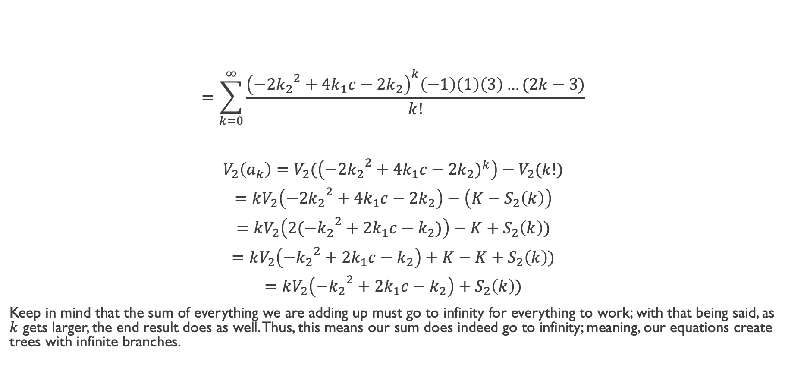
Theorem
$$=\sum_{k=0}^{∞}{\frac{{\left(−2{k_{2}}^{2}+4k_{1}c−2k_{2}\right)}^{k}\left(−1\right)\left(1\right)\left(3\right)…(2k−3)}{k!}}$$
$$V_{2}\left(a_{k}\right)=V_{2}(\left(−2{k_{2}}^{2}+4k_{1}c−2k_{2})^{k}\right)−V_{2}(k!)$$
$$=kV_{2}\left(−2{k_{2}}^{2}+4k_{1}c−2k_{2}\right)−\left(K−S_{2}\left(k\right)\right)$$
$$=kV_{2}\left(2(−{k_{2}}^{2}+2k_{1}c−k_{2})\right)−K+S_{2}\left(k\right))$$
$$=kV_{2}\left(−{k_{2}}^{2}+2k_{1}c−k_{2}\right)+K−K+S_{2}\left(k\right))$$
$$=kV_{2}\left(−{k_{2}}^{2}+2k_{1}c−k_{2}\right)+S_{2}\left(k\right))$$
Keep in mind that the sum of everything we are adding up must go to infinity for everything to work; with that being said, as $k$ gets larger, the end result does as well. Thus, this means our sum does indeed go to infinity; meaning, our equations create trees with infinite branches.

Slide 20
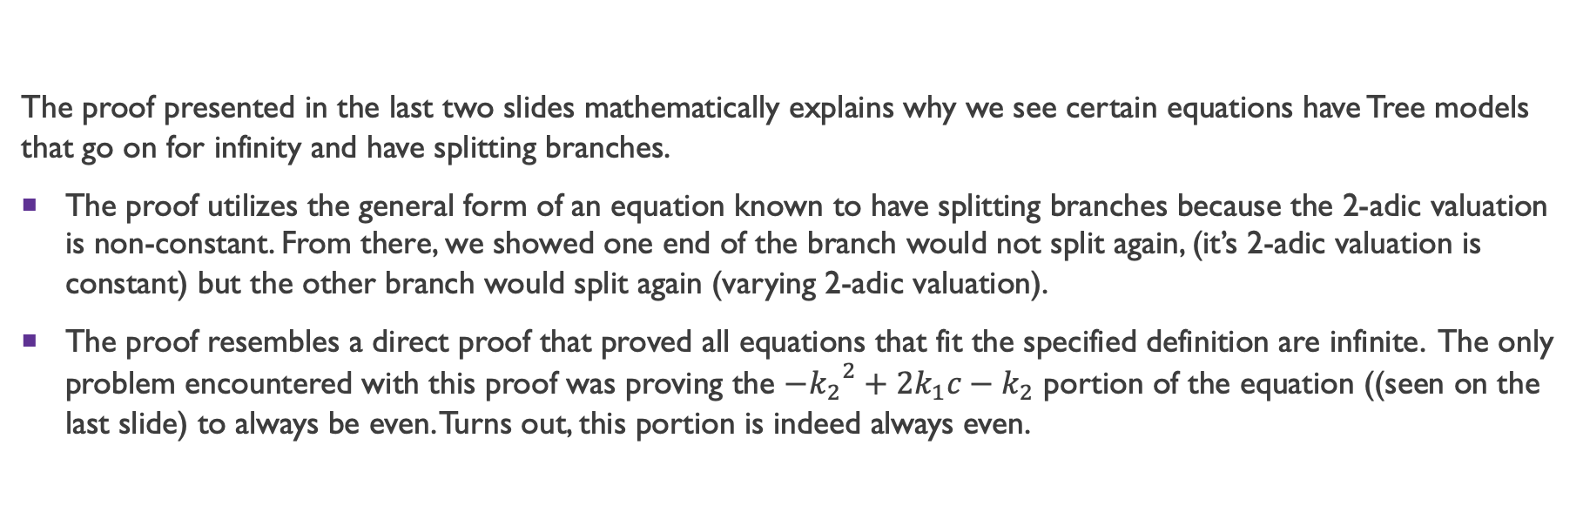
Theorem
The proof presented in the last two slides mathematically explains why we see certain equations have Tree models that go on for infinity and have splitting branches.
The proof utilizes the general form of an equation known to have splitting branches because the 2-adic valuation is non-constant. From there, we showed one end of the branch would not split again, (it’s 2-adic valuation is constant) but the other branch would split again (varying 2-adic valuation).
The proof resembles a direct proof that proved all equations that fit the specified definition are infinite. The only problem encountered with this proof was proving the $−{k_{2}}^{2}+2k_{1}c−k_{2}$ portion of the equation ((seen on the last slide) to always be even. Turns out, this portion is indeed always even.

Slide 21
Future Work
Publishing these results as part of a broader theory of quadratic functions.
  My advisor Dr. Trulen along with some colleagues and myself is formulating an essay that will be submitted to multiple academic journals for a possible publication!
Developing how the p-adic numbers play a bigger roll.
  We have somewhat an understanding of what we are dealing with and how these numbers function, but the next question is where can these findings be directly applied?
The 3-adic case
  Since we understand the 2-adic numbers, we are moving right along to the 3-adic numbers. We are seeing if patterns in the 2-adic cases can be translated over into the 3-adic world or if they are an unique case of their own.

Slide 22
References:
L.A. Medina et al., Periodicity in the p-adic valuation of a polynomial, J. Number Theory (2017), http://dx.doi.org/10.1016/j.jnt.2017.03.006
A.N. Byrnes, J. Fink, G. Lavigne, I. Nogues, S. Rajasekaran, A. Yuan, L. Almodovar, X. Guan, A. Kesarwani, L.A. Medina, E. Rowland, AND V.H. Moll. A Closed-Form Solution Might be Given by a Tree. Valuations of quadratic Polynomials. Scientia, Series A: Math. Sciences 29 (2019) 11-28.
Gouvêa Fernando Q. P-Adic Numbers: An Introduction. 1993.
J.L. Coolidge. The Story of the Binomial Theorem. The American Mathematical Monthly, 56(3), pp. 147-157, 1949

